Slide 1
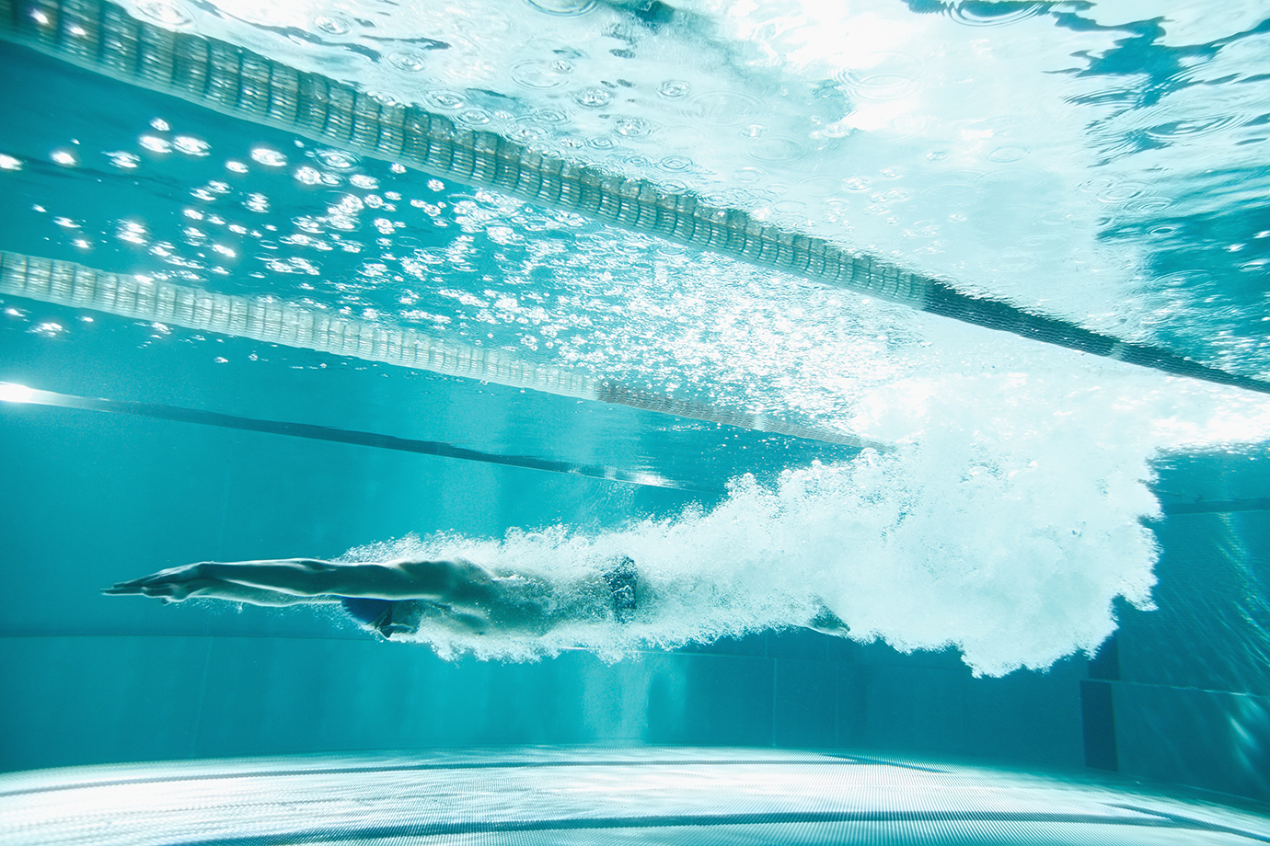
ASL High School Swimming
Coaches
Mission/Vision
Expectations
Practice schedule
Meets

Slide 2
COACHING STAFF
HEAD COACH
Apostolos Mitrakos
ASSISTANT:
Mark McVean
ASSISTANT:
Alex Coci
ASSISTANT:
Francesca Marr

Slide 3
Our Mission
To encourage swimmers to develop a passion for aquatics, feel pride through individual and team achievement while continuing to maintain the strong competitive swimming tradition of ASL.

Slide 4
ASL ATHLETIC PHILOSOPHY
The ASL Swim Team aligns with the Athletics curriculum which values:
sportsmanship and teamwork
commitment and discipline
competition and conflict management
skill and character development

Slide 5
Weekly Practice Schedule
Monday | Tuesday | Wednesday | Thursday | Friday
6:15-7:40 AM | 6:15-7:40 AM |  | 6:15-7:40 AM | 6:15-7:40 AM
16:00-18:00 Pool | 15:45-16:45 Fitness | 15:00-17:00 Pool
 | 16:45-18:00 Pool

Slide 6
Expectations
Varsity competitive swimmers are required to attend a minimum of FOUR practices a week(non club swimmers) and THREE practices a week(club swimmers).
All swimmers are required to attend a minimum of THREE practices a week to be part of the team.
All swimmers are expected to compete in all home meets

Slide 7
Meets
18th of January Cob-ASH-Zur @ASL (Home Meet)
25th of January 6-7 Schools @British School of Brussels
1st of February 3-4 Schools @ACS Cobham
8th of February SMASH @American School of The Hague
ISSTs Varsity Meet Away (British School Brussels) vs International Schools (12-14 March).

Slide 8
Volunteers Meet Parent Help
Parents will receive an email in which they can sign-up for a job at our home meet on Saturday 18th of January.
Thank you in advance as we greatly appreciate your support!

